Slide 1

Fit or Fail a revolutionary fitness game
Travis Stewart
Christian Sauls
Josh Shevitz

Slide 2
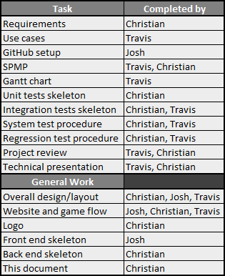
Roles and Contributions
Christian Sauls – Programmer (backend), coordinator, minor documenter, minor designer, minor frontend
Travis Stewart – Documenter (SPMP, use cases, Gantt chart, and more), minor designer
Josh Shevitz – Programmer (frontend), coordinator, designer

Slide 3
Purpose of The Game
Purpose
To create a fun, interactive learning experience that educates teens on consistent healthy lifestyle decisions such as diet and exercise
US Dept of Health and Human Services (DHHS) – “teens today are more likely to develop a sustained interest in a healthy, active lifestyle if they are provided with some type of technology-based “game-like” tool to stimulate their interest in the areas.“
Focus group: high school aged teens, eventually expanding to children of all ages
Primary platform: mobile

Slide 4
Technologies Used
Front end:
HTML/CSS
JavaScript
React
Bootstrap (possibly)
Back end
MongoDB
JavaScript
Express.js
JSON Web Tokens
Domain/Hosting provider
name.com (GitHub student developer pack)
Collaboration:
GitHub/Git
GroupMe
Google Hangouts
Miscellaneous
Various npm packages
Postman to make HTML requests for backend testing

Slide 5

About Our Game
Online multiplayer trivia game
Questions to be chosen randomly from a pool of fitness-related questions
Game modes:
Simple trivia:
Solo – Play by yourself, answering a handful of randomly-chosen questions
Kahoot!-style trivia:
Online – Play for points competitively against other individuals
Users can create and join “Teams”
User accounts store data for cumulative points earned and total match victories
Users in a Team contribute their earnings to their Team’s statistics as well

Slide 6
Current Status
Clear goals
Our frontend is still in heavy development
Learning React
Backend has basic functionality
Database
Stores Users, Teams, Questions to choose from
Register/Log in
Still hooking everything together

Slide 7
Planned Pages
Index
Homepage/Welcome screen
Big play button, either prompting the user to log in, or taking them directly to the Game page if already logged in
Game
User profile
See User’s statistics
Team page
See Team’s statistics
Leaderboards
See top-ranking Users and Teams

Slide 8
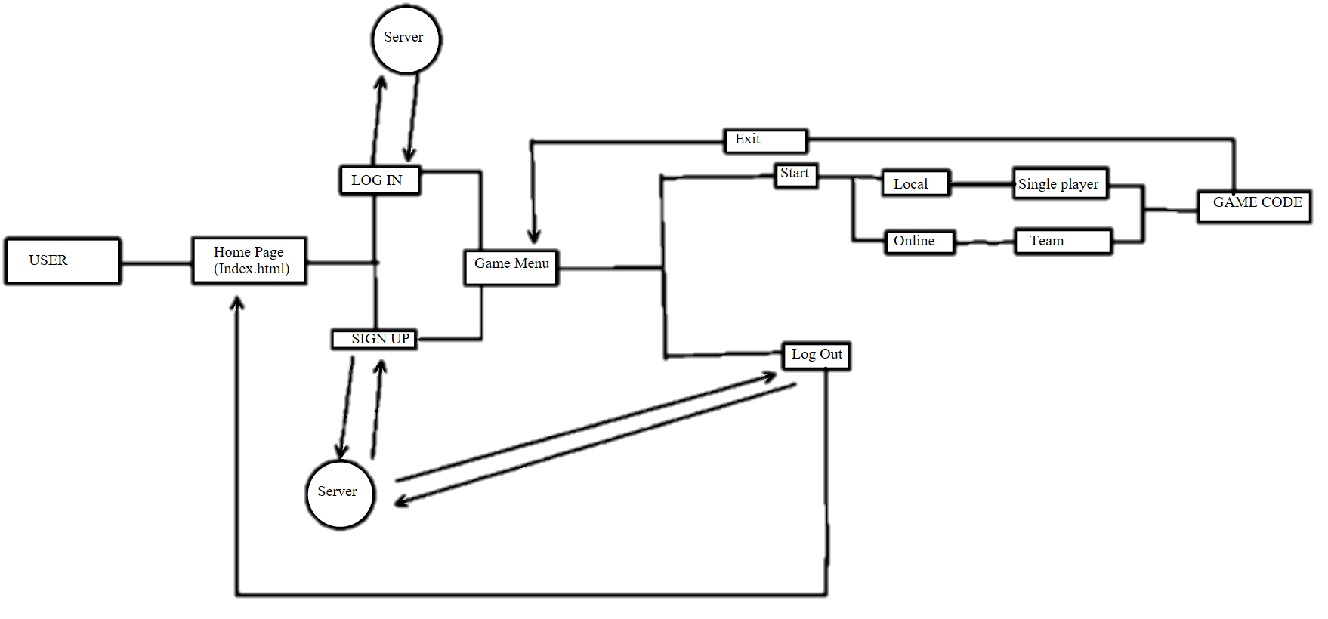
Website game layout

Slide 9
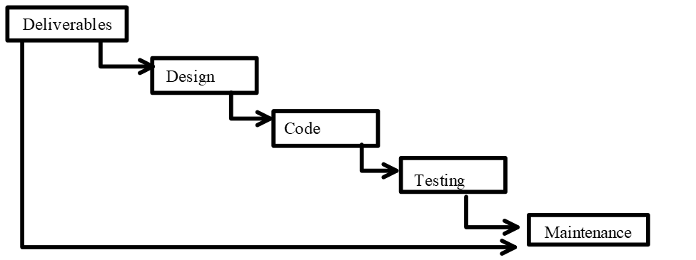
Process model
This project will be using the waterfall model
Has many phases/parts
Each part relies on the previous parts
Waterfall model parts (in order)
Requirements Analysis
Design
Implementation
Verification/Testing
Maintenance.

Slide 10
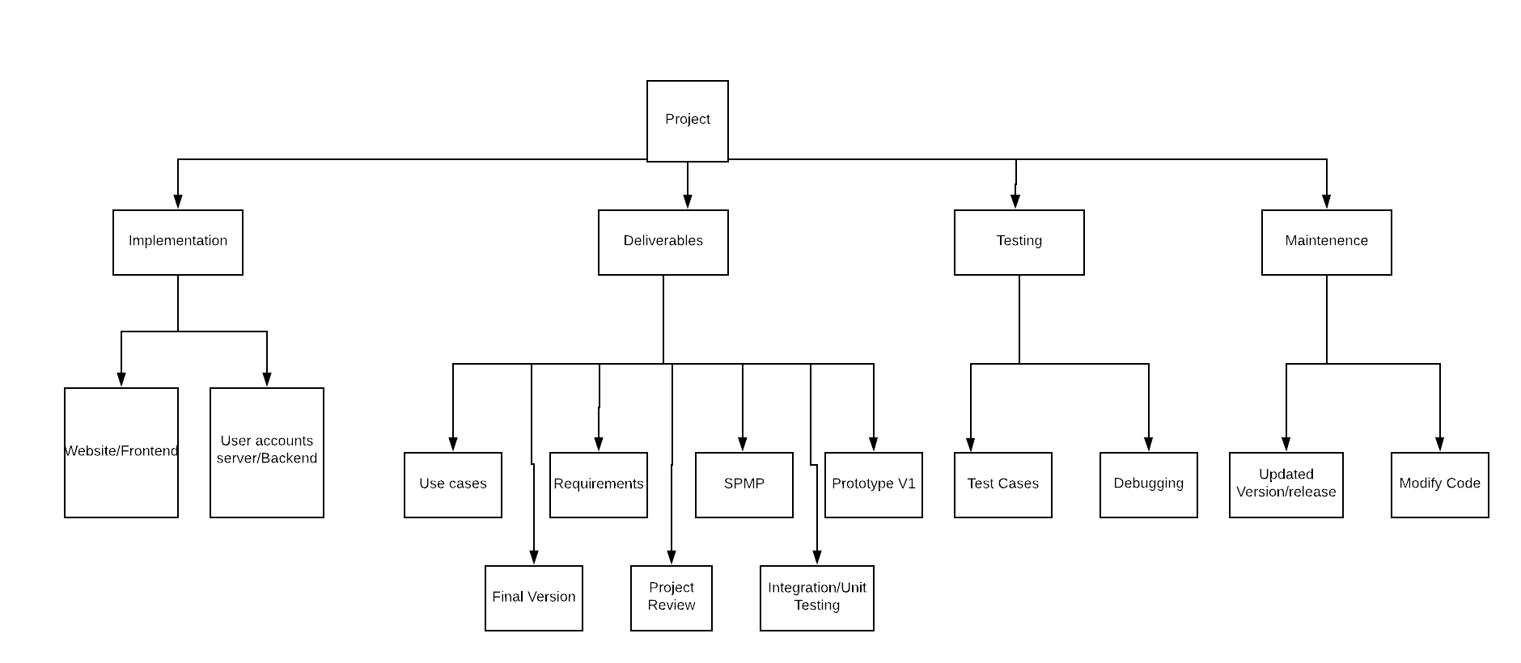
Work Breakdown Structure

Slide 11
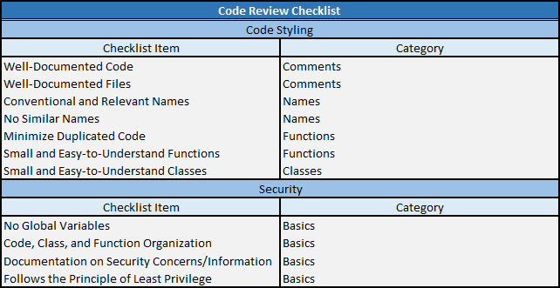
Project Review: I

Slide 12
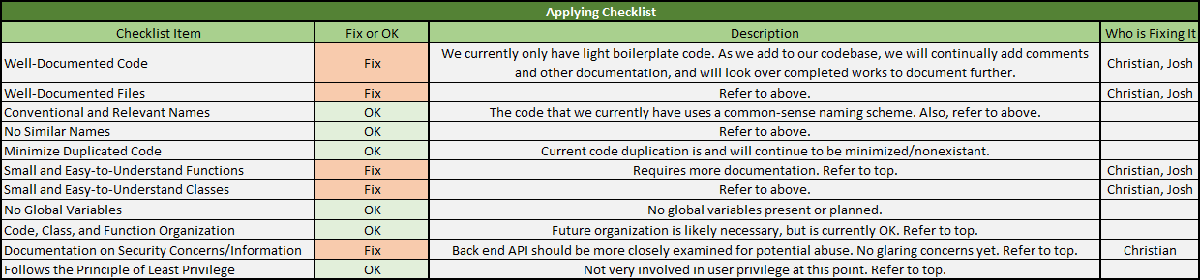
Project Review: II (Project Review: III Coming Soon)

Slide 13


Challenges Faced
Our collective webdev experience equates to basic static HTML pages
Learning:
Miscellaneous webdev vocabulary
Git
JavaScript
Frameworks
React, Bootstrap
Node/Express
User authentication
Databases

Slide 14
Our To-do List
Create working frontend prototype, working incrementally
Login/Register page
Connect to backend
Game
Local
Online
Advertising
User pages
Team pages
Public leaderboards
Expand upon backend functionality
Donations
Monitoring
Everything else as needed
Acquire hosting, have it be live
Expand upon testing skeleton

